Slide 1
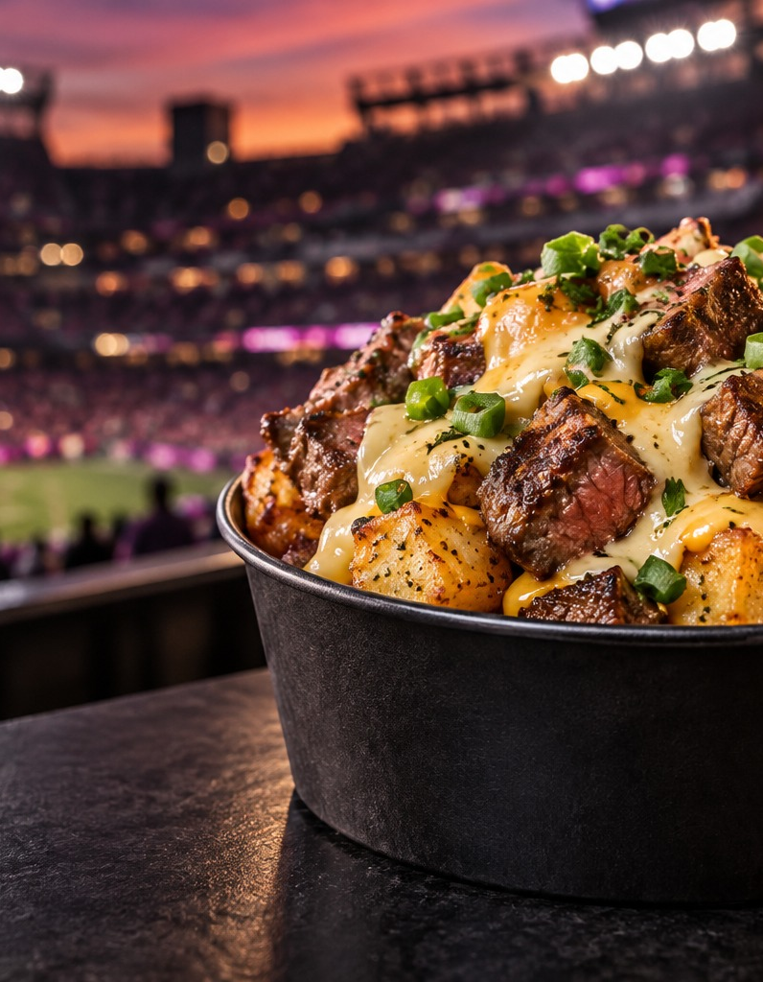

AVENUE29 FOODS
01
Brand Activations
Food & Beverage Operations
Distribution
For brands, festivals
and venue partners
Venue program concept · Illustrative imagery
Notes:
Company overview based on Nicholas’s proposed three-division model, October 26, 2026. Hero image is generated illustrative imagery, not a photograph of an existing stadium program.

Slide 2
AVENUE29 FOODS
02
One company. Three connected services.
Brand Activations
Brand experiences and festival sponsor activations.
Concept, production and delivery
Food & Beverage
Operations
Festival program management and licensed Avenue29 food programs for venues.
Festival management and venue licensing
Distribution
Market development and product supply for food and beverage brands.
Retail, foodservice, festivals and venues
Notes:
Revenue structures are proposed options for negotiation. These divisions are operating functions and do not determine corporate legal structure. Existing festival and catering experience forms the foundation. Distribution and venue licensing relationships are being developed.

Slide 3
AVENUE29 FOODS
03
Brand Activations
Your brand.
Part of the experience.
Festival sponsor activations and tours
Culinary integration and sampling
Staffing, logistics and live production
Agreed reporting and content capture
For brands and festival organizers: experiences shaped around sponsor goals and the audience.
Notes:
Production is the initial paid engagement. The client funds the defined program before corresponding commitments. Event access, responsibilities, content rights and food sales ownership require agreement. No specific national event access or brand clients are claimed.

Slide 4
AVENUE29 FOODS
04
Distribution and market development
More markets.
More places to reach
your customer.
Retail and foodservice accounts
Festival and venue product supply
Workplace refreshment programs
Buyer and fulfillment partnerships
Snacks, beverages and other food products. Distribution can follow an activation or stand on its own. Supply and fulfillment responsibilities are agreed for each engagement.
Notes:
Avenue29 can act as a broker or representative, coordinate with a distribution partner, or buy and resell inventory where capability and economics support it. These are distinct roles. Capital raised by a prospect does not establish an available marketing budget. No shelf placement or existing national distribution capability is guaranteed.

Slide 5
AVENUE29 FOODS
05
Food & Beverage Operations
Licensed venue programs.
12 years in festivals.
Your team runs it.
Menu concepts and recipe specifications
Portions, prep and service standards
Operator training and launch support
Approved sourcing or agreed supply
Brand standards and quality reviews
The venue or concession operator licenses and runs the Avenue29 program. Starting concepts include smashburger bowls, Philly steak & cheese and loaded fries.
Notes:
Proposed licensing offer, not a claim of existing stadium licensees. The full menu portfolio is available for evaluation but an initial venue should select a manageable set. Partner with venue leadership and the authorized foodservice operator. Supply can use approved ingredients, a partner manufacturer or separately contracted product supply. Brand licensing does not automatically make Avenue29 the full concession manager.

Slide 6
AVENUE29 FOODS
06
Food & Beverage Operations: Festivals
01
Plan the operation
Define the menu, service model, staffing, equipment and purchasing responsibilities.
02
Manage the service
Coordinate site leadership, crews, suppliers, preparation and guest-facing execution.
03
Measure and improve
Review labor, purchasing, waste, service speed and contribution against agreed goals.
Festival program management, tailored to the event and its operating responsibilities
Notes:
Recommended starting pilot rather than committing the entire menu or promising revenue increases. Financial review should account for cannibalization of existing items, food cost, labor, packaging, venue/operator shares and license fees. Outcomes are objectives to measure, not guaranteed improvements.

Slide 7
AVENUE29 FOODS
07
Three clients. A clear starting point.
For brands
For festivals
For venues
Introduce your product through an activation.
Develop distribution in the right channels.
Activate sponsor partnerships.
Manage the food and beverage program.
Explore product supply.
License the Avenue29 food program for your operator to run.
Receive training, standards and launch support.
Explore product supply.
Start with one service. Combine services when the opportunity supports it.
Notes:
External company overview. In many stadiums an incumbent foodservice operator controls the food program, so introductions should include that operator. Example primary source: https://www.lucasoilstadium.com/attending-an-event/concessions/ identifies Sodexo Live! as sole licensed F&B operator. This is an industry example, not an Avenue29 partner.

Slide 8
AVENUE29 FOODS
08
Let’s build the right partnership
Nicholas P Mussolini
Chief Executive Officer
nicholas@avenue29foods.com
Office: 716-799-1772
Cell: 716-574-1188
avenue29foods.com
Notes:
Contact details supplied by Nicholas. No partner logos, customer testimonials or unsupported financial projections are included.

